Slide 1

LECTURE-3
BT101- Introductory Biology
Dr. Kusum K. Singh
Department of Biosciences and Bioengineering
Indian Institute of Technology Guwahati

Slide 2
Discovery of DNA
Contents:
History: Finding DNA as genetic material.
Various scientists contributions.
Important experiments.
Conclusions from the experiments.
Till famous Watson-Crick DNA model.

Slide 3
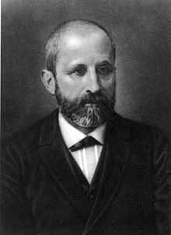
Discovery of DNA
History of finding DNA as genetic material:
When and How the DNA was discovered??
1868 Swiss Chemist
White Blood cells = Pus coated bandages
Used various salt solutions (acids & alkalis)
Which he called ‘nuclein’ inside the nuclei of human white blood cells
He isolated something new from the nuclei of eukaryotic cells: published in 1874
Discovered DNA
Johann Friedrich Miescher

Slide 4
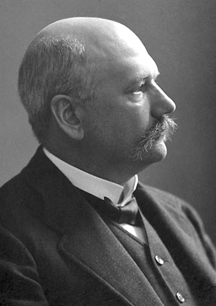
Discovery of DNA
History of finding DNA as genetic material:
When and How the DNA was discovered??
1881 German Biochemist
Identified nuclein as a nucleic acid.
He isolated five nucleotide bases: adenine (A), cytosine (C), guanine (G)
Thymine (T) and Uracil (U) that are building blocks of DNA and RNA; nuclei of human white blood cells
Nobel Prize: in year 1910
Albrecht Kossel

Slide 5
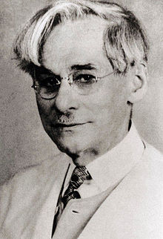
Discovery of DNA
History of finding DNA as genetic material:
When and How the DNA was discovered??
1919 Russian Biochemist
Discovered three major components of nucleotide (phosphate, sugar and base)
First to discover carbohydrate component of DNA (deoxyribose) and RNA (ribose)
First to propose ‘polynucleotide’ model (yeast nucleic acid)
Tetranucleotide model G-C-T-A-G-C-T-A
Phoebus Levene

Slide 6
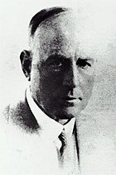
Discovery of DNA
History of finding DNA as genetic material:
When and How the DNA was discovered??
1928 British Bacteriologist.
Focus was epidemiology and pathology of bacterial pneumonia.
He studied effects of virulent bacteria versus non-virulent bacteria.
Model organism: Mice
Frederick Griffith

Slide 7
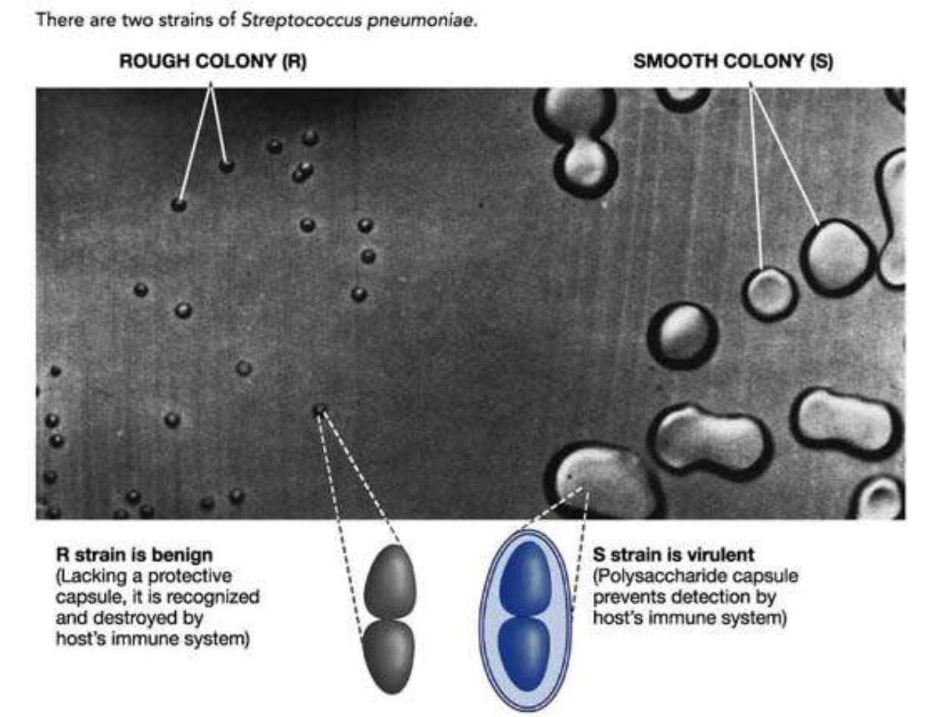


Discovery of DNA
“Transforming Principle”:

Slide 8
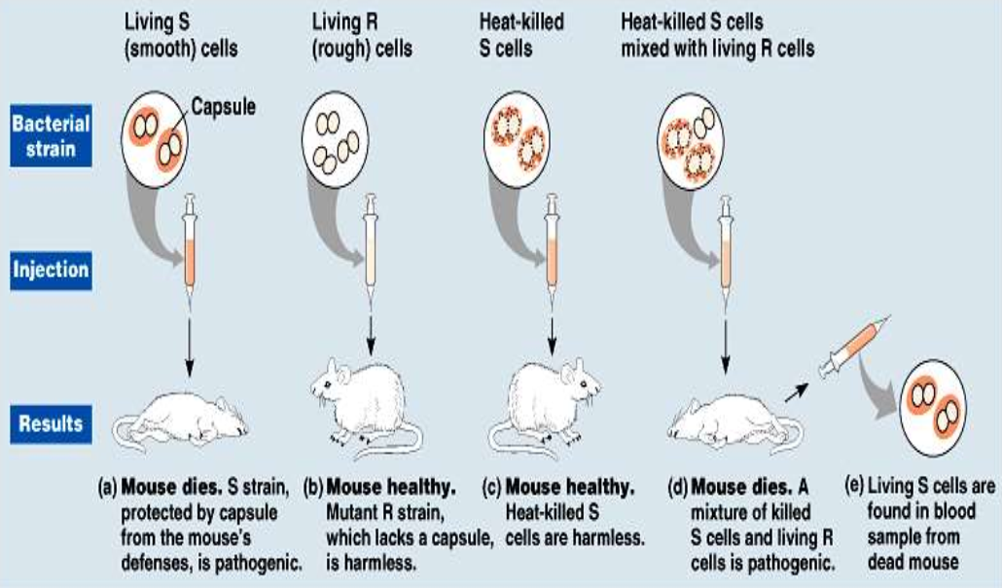
Discovery of DNA
“Transforming Principle”:
Griffith's experiment : "transforming principle" in pneumococcus bacteria.

Slide 9
Discovery of DNA
Transforming agent in Griffith’s experiment was DNA:
In year 1944 famous Scientists
Oswald Avery
Colin Macleod
Maclyn McCarty

Slide 10
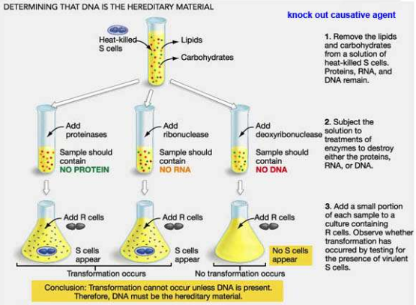
Discovery of DNA
Transforming agent in Griffith’s experiment was DNA:
They used pneumococcus bacteria & mice test-tubes
Oswald Avery
Colin Macleod
Maclyn McCarty

Slide 11
Discovery of DNA
Transforming agent in Griffith’s experiment was DNA:
They used pneumococcus bacteria & mice test-tubes
Oswald Avery
Colin Macleod
Maclyn McCarty

Slide 12
Discovery of DNA
Transforming agent in Griffith’s experiment was DNA:
They used pneumococcus bacteria & mice test-tubes

Slide 13
Discovery of DNA
History of finding DNA as genetic material:
In year 1952 Martha Chase & Hershey used bacteria & bacteriophages
Alfred Hershey & Martha Chase
Which portion of phage stay outside ? and what enters the bacterial cell was unknown…
Model organism: Bacteriophage and bacteria

Slide 14
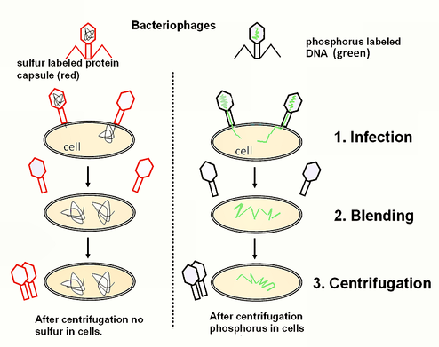
Discovery of DNA
History of finding DNA as genetic material:
In year 1952 Martha Chase & Hershey used bacteria & bacteriophages

Slide 15
Discovery of DNA
History of finding DNA as genetic material:
Conclusion of Hershey and Chase experiment:
Phage coat labelled with S³⁵ did not enter into the bacteria.
Phage DNA labelled with P³² enters into the bacteria.
DNA carries all the genetic information for synthesis of new phage particles.
Clearly shows DNA as the genetic material.
Nobel Prize: 1969 together with Delbrück and Salvador Luria.

Slide 16
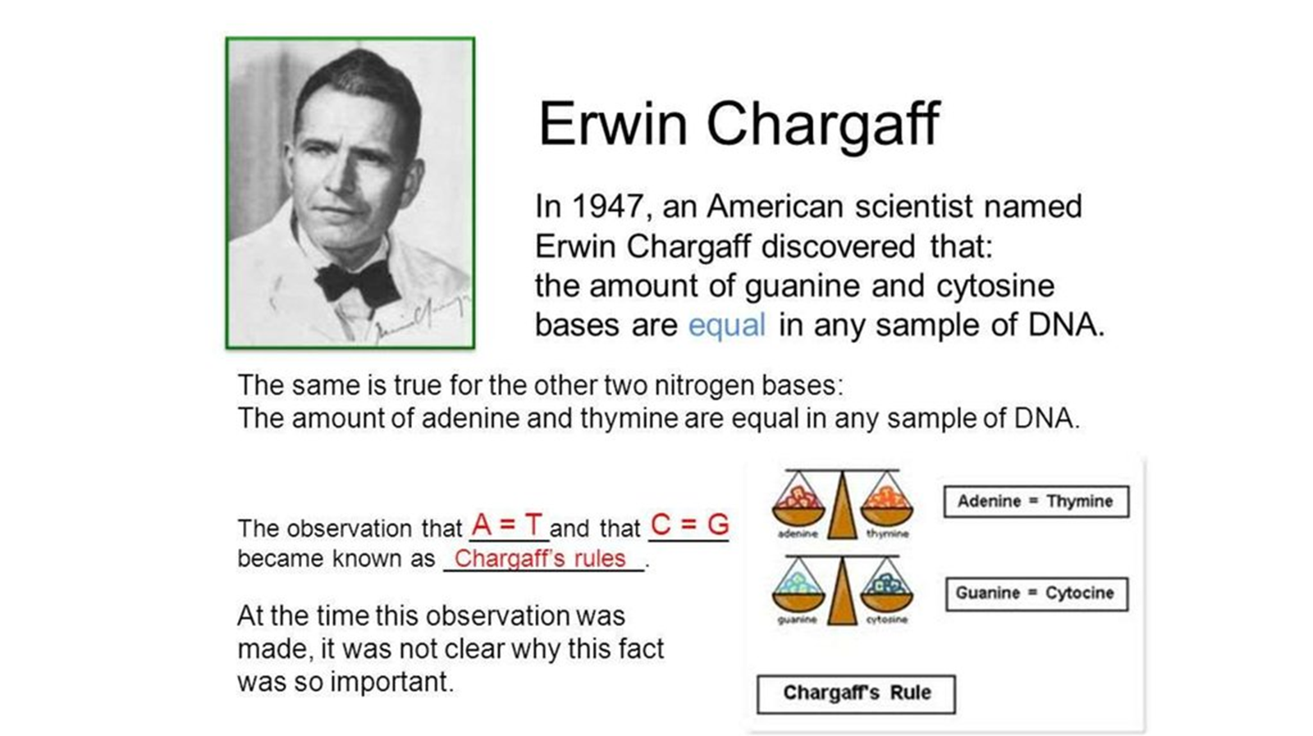
Discovery of DNA
History of finding DNA as genetic material:
When and How the DNA was discovered??
Between 1947 to 1950; American Scientist.
Discovered: amount of Guanine and Cytosine bases are equal in any sample of DNA.
Also, the amount of Adenine and Thymine are equal in any sample of DNA.
Erwin Chargaff

Slide 17
Discovery of DNA
What we have learned so far:
1866 - Gregor Mendel Paper “Principle of Inheritance”.
1868 - Friedrich Miescher discovers “nuclein” from WBC.
1919 - Phoebus leuvene discovers “phosphate, sugar and bases”; polynucleotide.
1928 - Frederick Griffith “Transforming Principle”.
1944 - Avery-MacLeod-McCarthy experiment “DNA as transforming agent”.
1950 - Erwin Chargaff : “A=T and G=C”.
1952 - Hershey & Chase: “DNA as genetic material”.

Slide 18
Discovery of DNA
What was unknown till 1953 :
Although the chemical components of DNA i.e. Phosphate, Sugar and four bases (A, T, G and C) were known but…
….In which fashion these are connected to each other was unknown.
What is the structure of DNA genetic material?

Slide 19
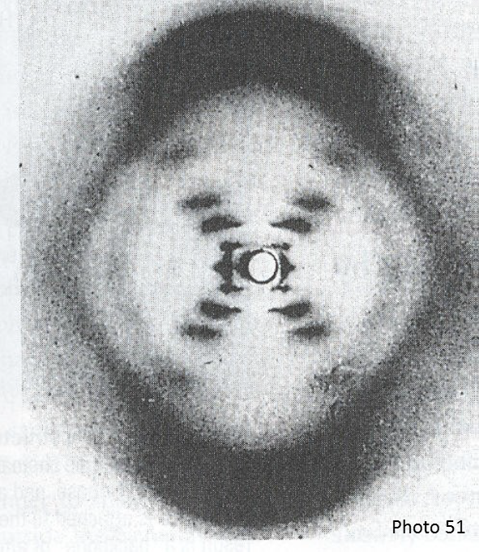
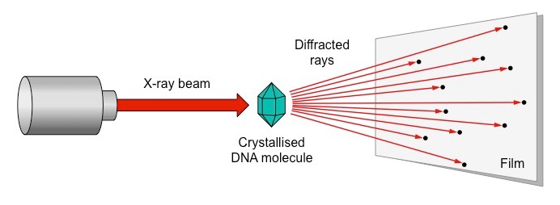
Discovery of DNA & its Structure
To obtain DNA structure:
In 1950’s: Rosalind Franklin and Maurice Wilkins used X-ray diffraction
Rosalind Franklin
Maurice Wilkins

Slide 20
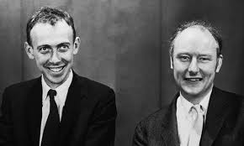
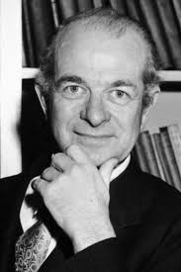
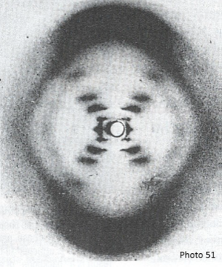
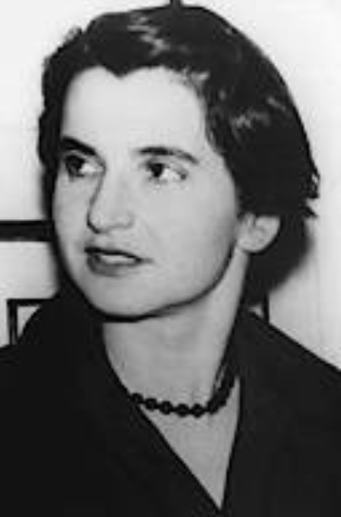

Discovery of DNA
To obtain DNA structure:
James Watson and Francis Crick
Linus Pauling
Maurice Wilkins

Slide 21
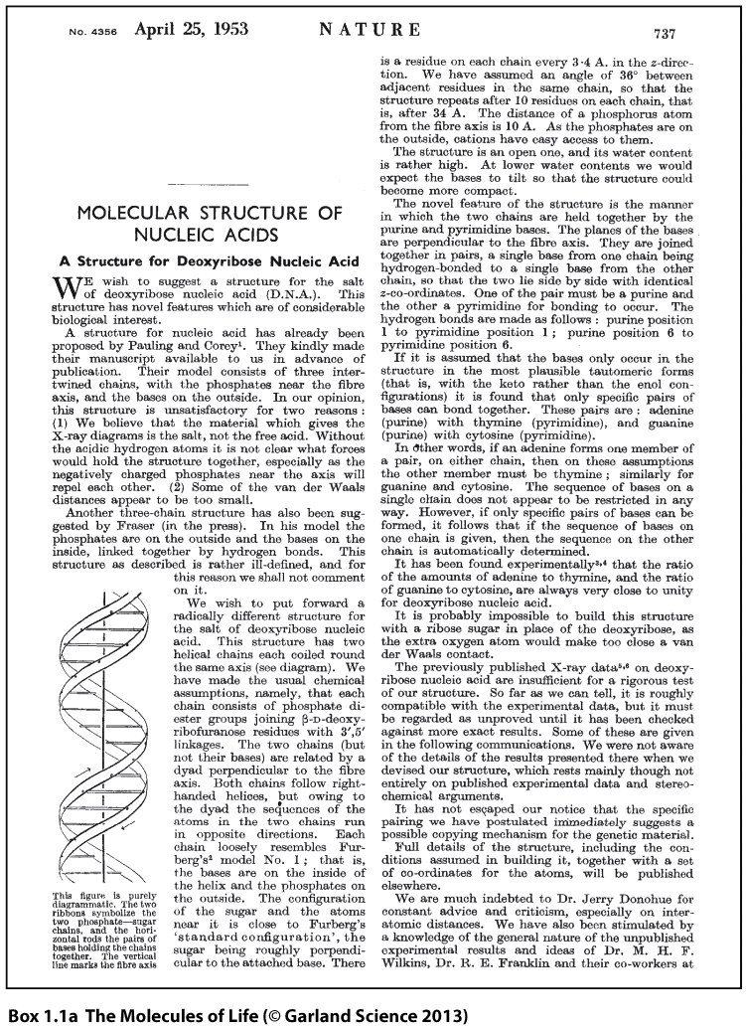
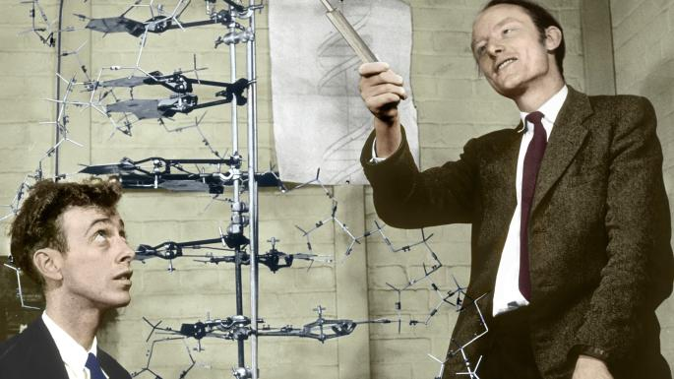
James Watson & Francis Crick - 1953
•Watson Crick Model
•“Double Helix”
•Determined the shape and structure
•Adenine bonds with Thymine
•Cytosine bonds with Guanine
Nobel Prize: in year 1962

Slide 22
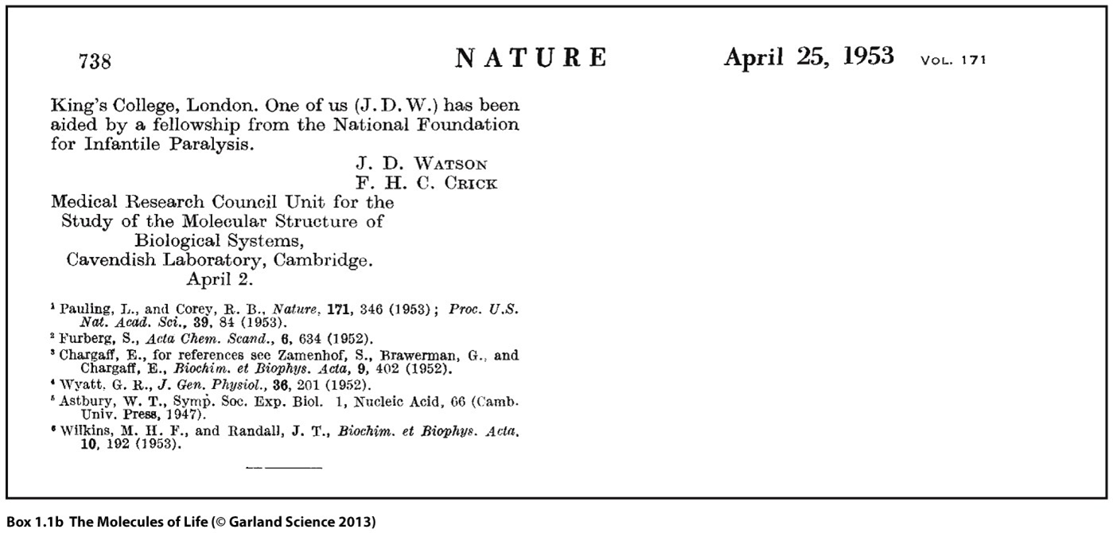

Slide 23
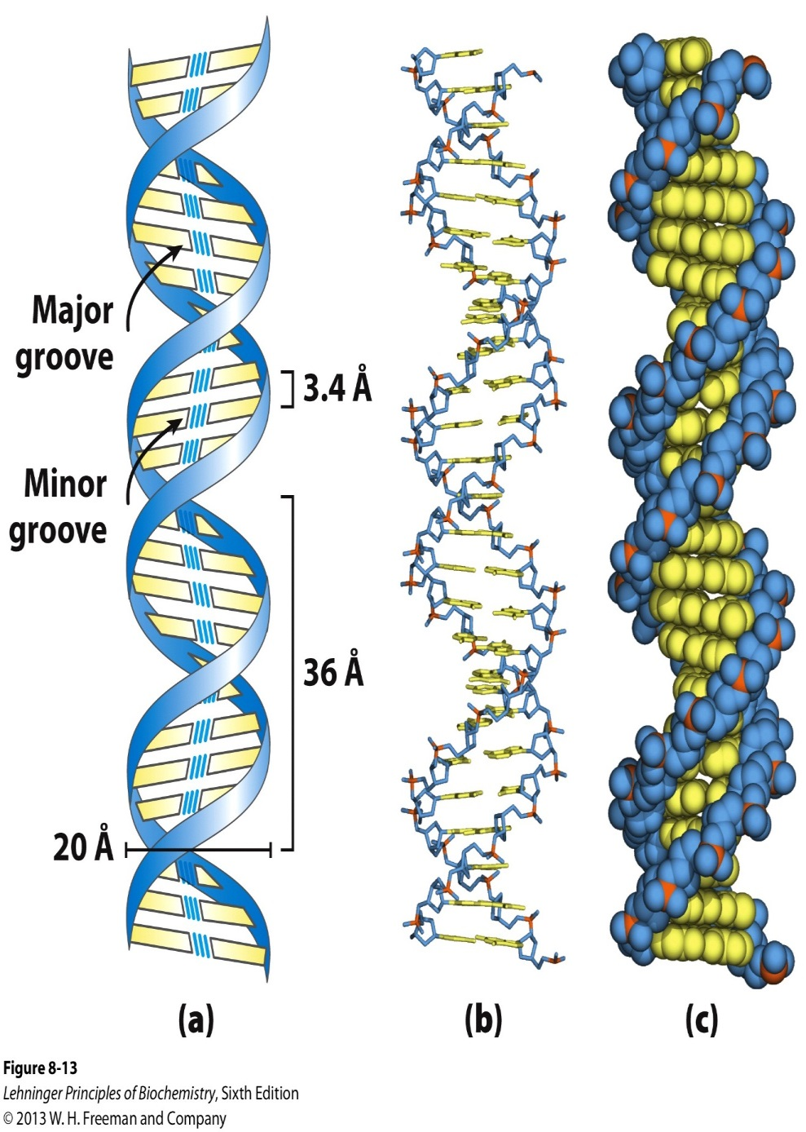
Watson-Crick Model of B-DNA
Notes:
LEGEND 8.13

Slide 24
Conclusions of Lecture-3
Brief history of finding DNA as genetic material.
Model building to solve the structure of DNA.
Double helix separated by 2 nm, Phosphate and Sugar form the backbones of DNA.
Nitrogenous bases (A=T/ G ≡ C) are tucked inside.
~ 10 bases/turn and twist every 3.6 nm

Slide 25
Types of Questions?
Explain Griffith Experiment.
What molecules were labelled in Hershey and Chase experiment?
How can you prove DNA is the genetic material?
If there is 34% of A then What % of G is present in the DNA sample.
Why nitrogenous bases are placed inside??

Slide 26
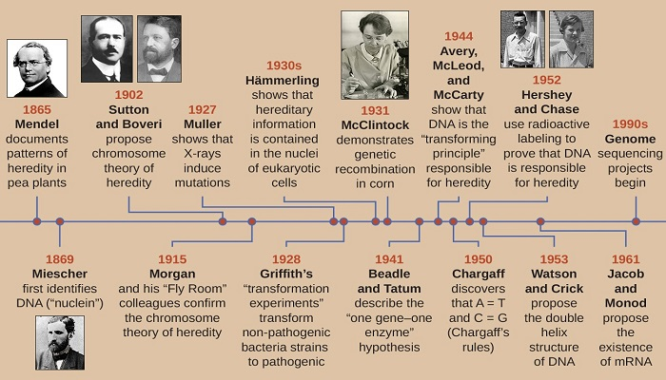

Slide 27
Thank You!

